Slide 1
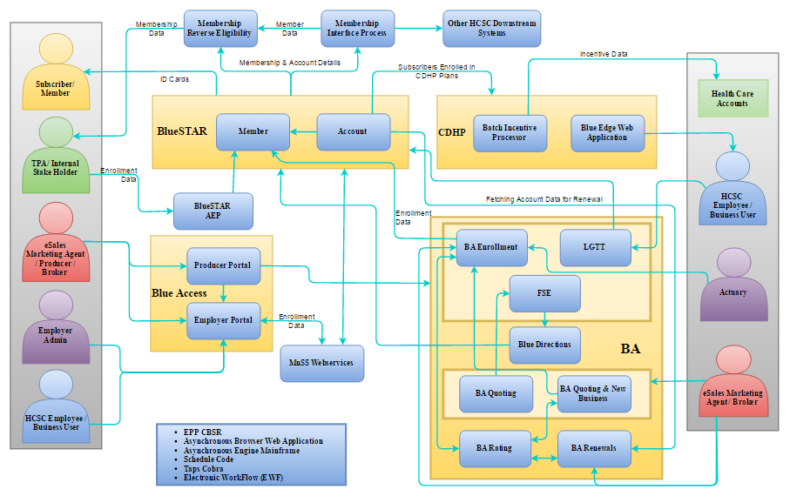
Markets Business Context Diagram

Slide 2
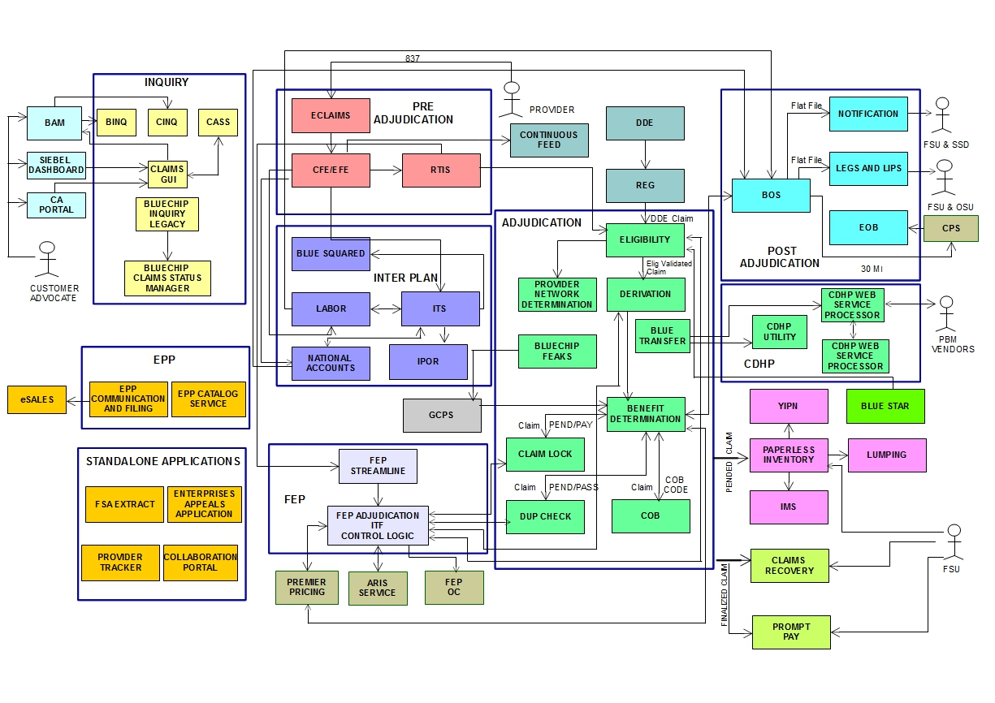
Claims Processing – Context diagram

Slide 3
Appendix

Slide 4
Business Acquisition

Slide 5
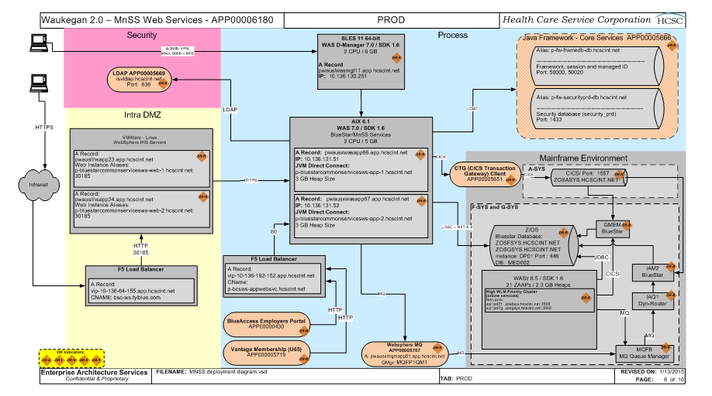
BlueSTAR MNSS services

Slide 6
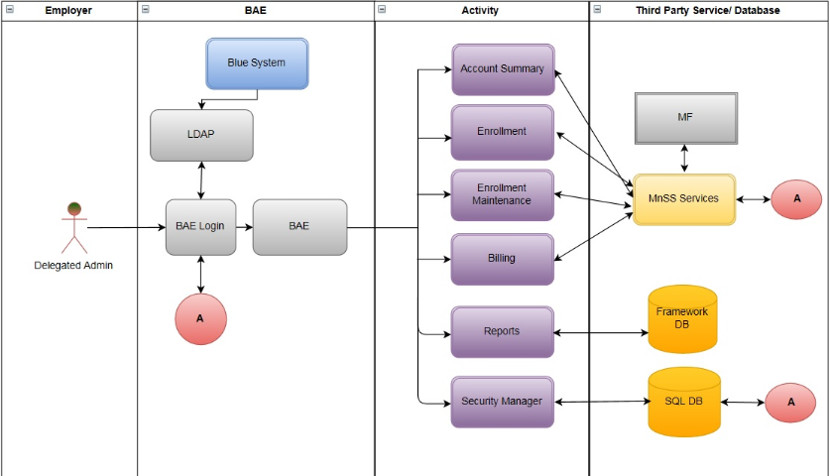
Standalone - BAE

Slide 7
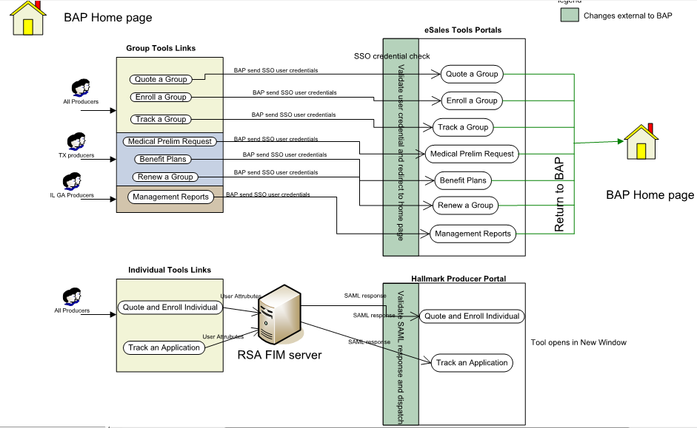
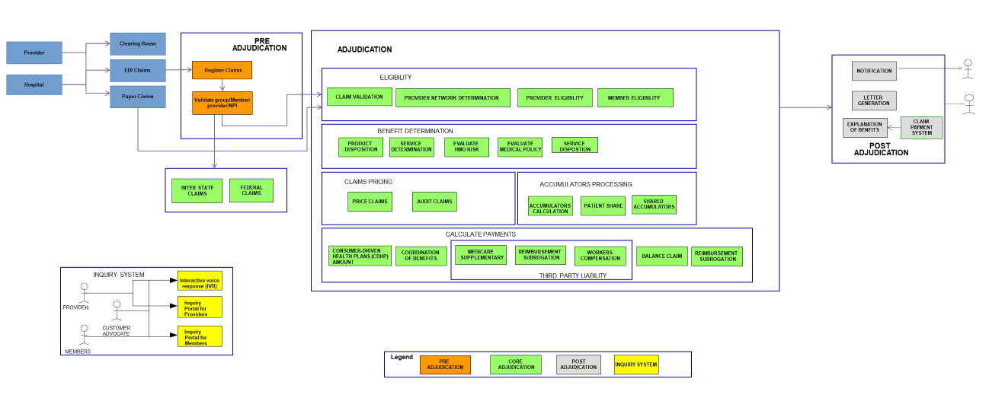
Standalone - BAP

Slide 8
claims

Slide 9
Claims Processing – Context diagram (High level)
Core-adjudication
Pre-
adjudication
Route the expectation into appropriate mailbox
Based on Claims rules
Pre-authorization
Fraud
Duplicate check
Coordination of Benefits
Perform the Initial Edits
Receive the Claims
Member Verification
Provider Verification
Auto Adjudication
Post-
adjudication
EDI
Paper Claims
Phone/IVR
FAX/Email
Claims Payment
Load the Claims into System
Audit
backend
Suspended claims for Audit review
Batch Process
Generate the EOB
Send it to Finance
No Error
Record the claim
Audit
Frontend
Audit Review
Route to Claims examiner for adjustment
Error
Review Claims amount against set Criteria
If there is an error send to claims examiner

